Slide 1
Distribution Coordinates

Slide 2
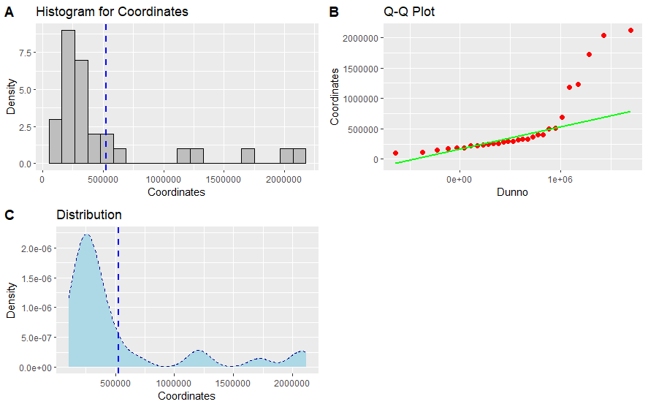
Old Data All Graphs

Slide 3
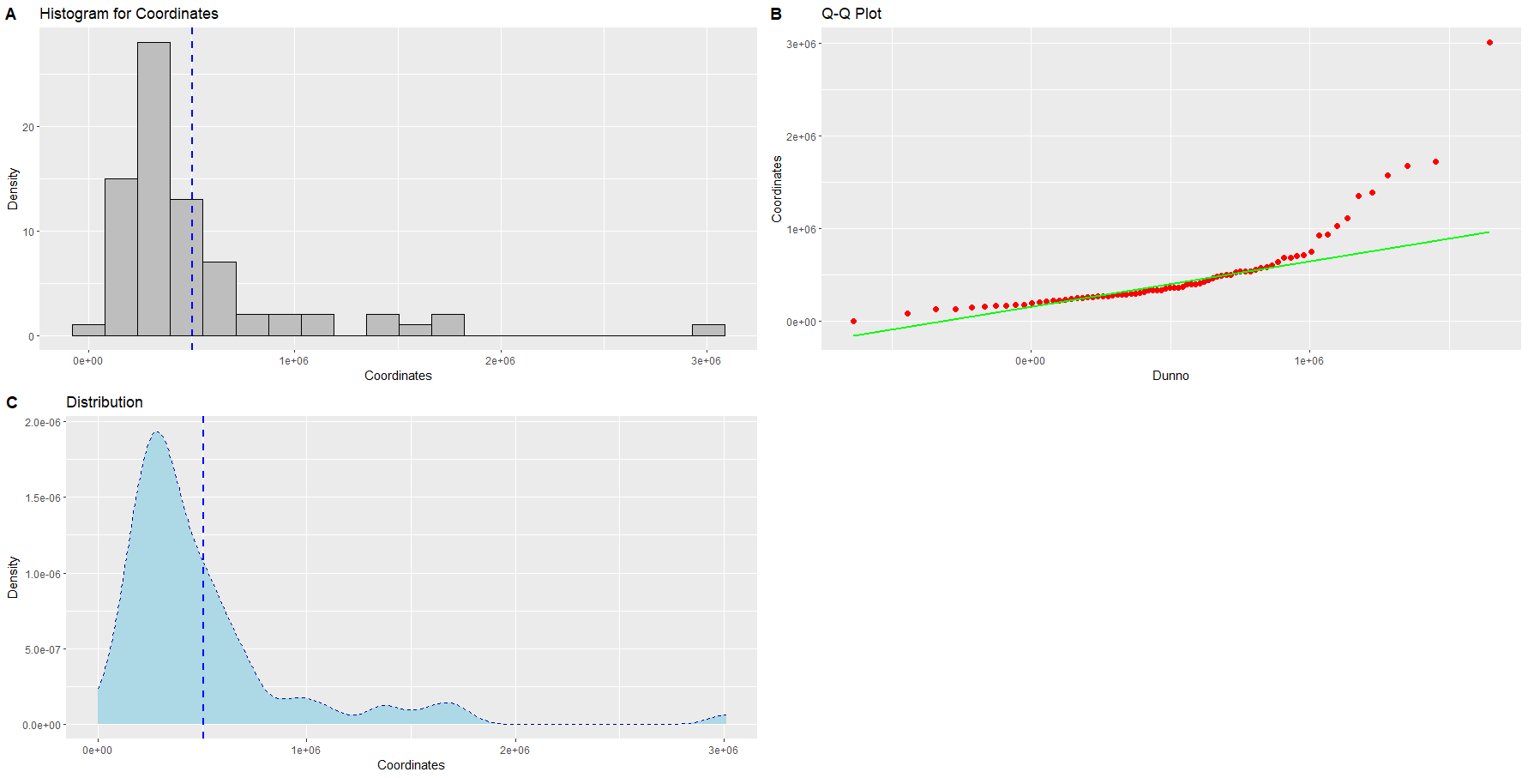
Data (n=76) All Graphs

Slide 4
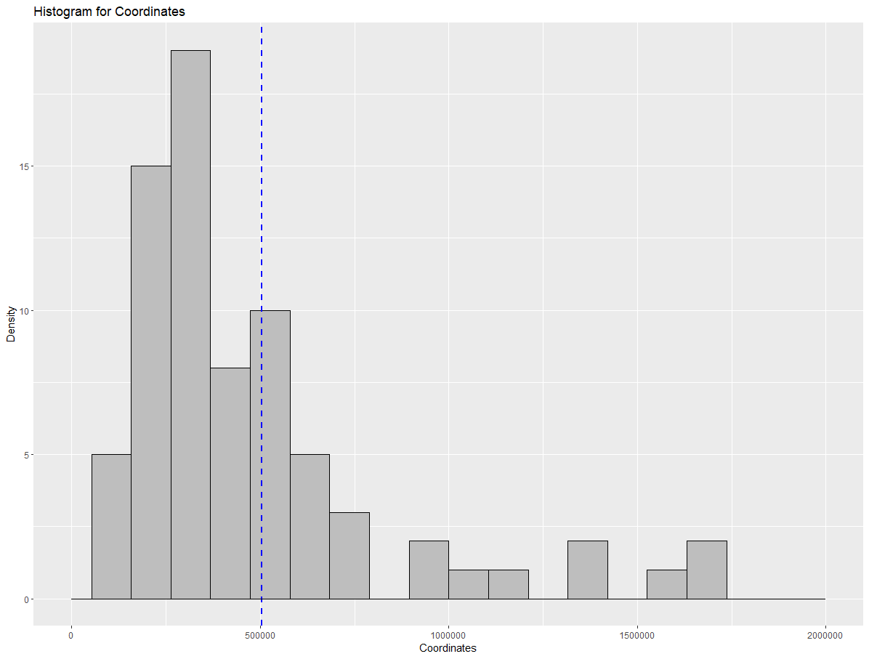
Data (n=76) Histogram (X-axis limited to 2e6))

Slide 5
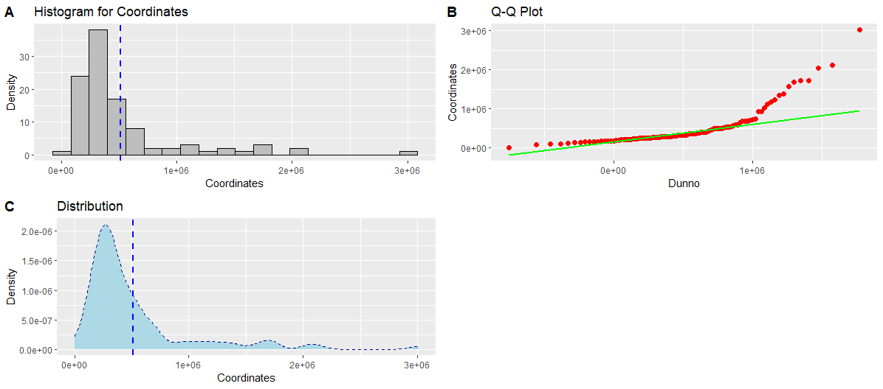
Data (n=105) All Graphs

Slide 6
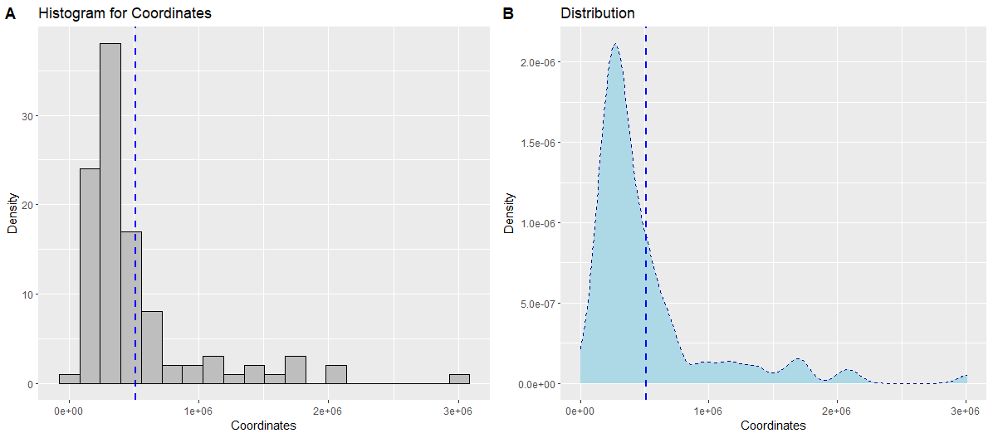
Data (n=105) Density

Slide 7
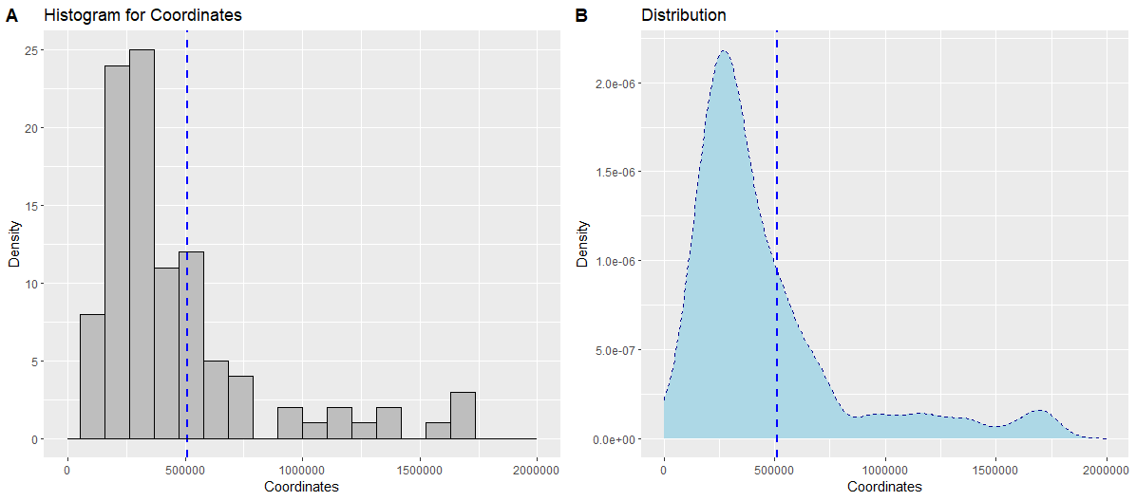
Data (n=105) Density (X-axis limited to 2e6)

